Slide 1
Chapter 09 Exceptions
FALL 2021

Slide 2
Objectives
Understand Java Exceptions
Learn how to define new types of exceptions
Differentiate between the different types of exceptions

Slide 3
Outline
Introduction
Java Exceptions advantages
Syntax
Example
New Exception types
Exception hierarchy
Different types of exceptions
Control flow and exceptions

Slide 4
Introduction
Users have high expectations for the code we produce.
Users will use our programs in unexpected ways
An exception is an even that is not supposed to occur, it disrupts the normal flow of control in a program
It is our responsibility to produce quality code that does not fail unexpectedly
Consequently, we much design error handling into our programs

Slide 5
Exceptions
Some exceptions (like division by zero) are avoidable through careful programming.
Some exceptions (like losing a network connection) are not avoidable or predictable
Java allows programmers to define their own code of handling exceptions when they occur.

Slide 6
Examples of Errors
Some of the events that cause errors:
Very unusual
Memory errors (i.e., memory incorrectly allocated, memory leaks, “null pointer”)
File system errors (i.e., disk is full, disk has been removed)
Logical
Calculation errors (i.e., divide by 0)
Array errors (i.e., accessing element -1)
Can be detected and raised deliberately
Conversion errors
Network errors
File errors

Slide 7
Java Exceptions
Exceptions are objects
When an error occurs in a Java method or constructor:
The method creates an exception object
The exception object contains information about the exception, including its type and the state of the program when the errors occurred.
Then it throws it to the runtime system (gives it to the runtime system)
The runtime system is then responsible for finding some code to handle the error.
If the runtime cannot find an appropriate exception handler, the runtime system (and consequently the Java program) terminates.

Slide 8
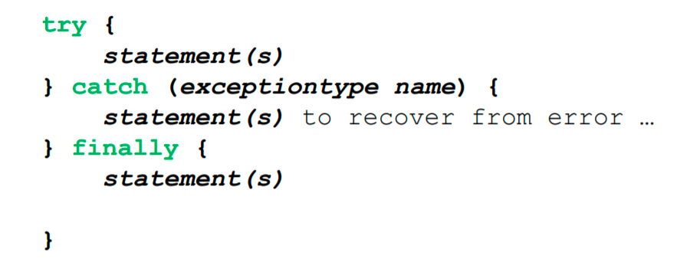
Exception Handling – Syntax
Three statements play a role in handling exceptions in Java:

Slide 9
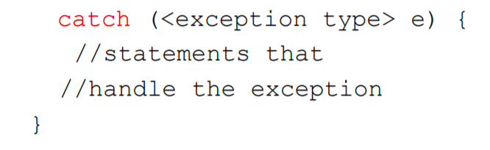
Throwing and Catching
A method or constructor can throw an exception
The method throwing an exception should declare it
Exception handlers can catch specified exceptions and recover from errors.

Slide 10
Keywords for Java Exceptions
Throws
Describes the exceptions which can be raised by a method
Throw
Used to signal the occurrence of an exception and return control to the calling method
Try
Marks the start of a block associated with a set of exception handlers
Catch
If the block enclosed by the try generates an exception of this type, control moves here
Finally
Always called when the try block concludes, and after necessary catch handler is complete.

Slide 11
Example
Posted online

Slide 12
Supertype and Subtype Exception Handling
In Java, the catch blocks are triggered in the order in which they appear in the source file
Thus, special (sub) type exceptions should be caught before the general (super) type exceptions
In the more general exception catch block comes first, it will trigger also if a sub type exception is thrown, and the second special exception catch block will be unreachable.

Slide 13
Exceptions: flow of control
Exceptions break the normal flow of control
Termination Model:
When an exception occurs, the statement that would normally execute next is not executed.

Slide 14
Java is strict
Unlike C++, is quite strict about catching exceptions
If it is a checked exception
Java compiler forces the caller
Must either catch it
Or explicitly re-throw it again
Why is this a good idea?
By enforcing exception specifications from top to bottom, Java guarantees that exceptions are not ignored

Slide 15
Java Exceptions – Advantages
By using exceptions to manage errors, Java programs have the following advantages over traditional error management techniques:
Separating error handling code from regular code
Propagating errors up the call stack
Grouping error types and error differentiation

Slide 16
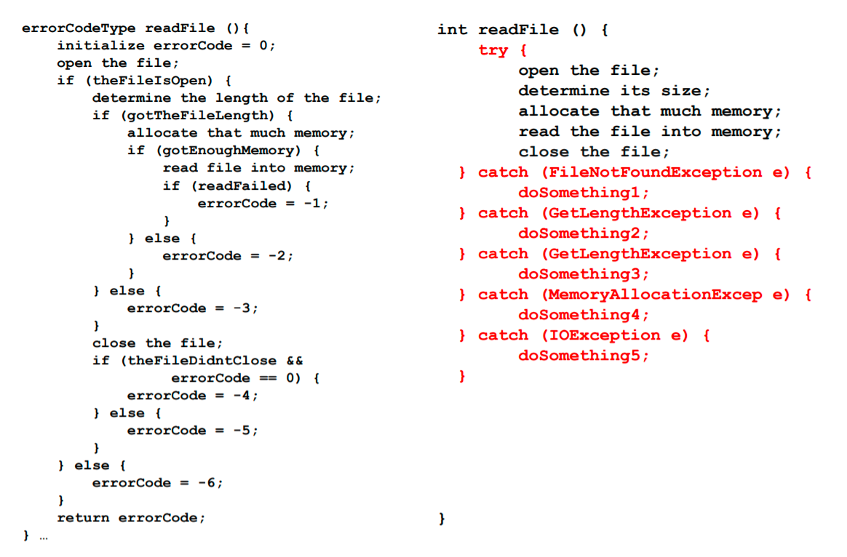
Separating Error Code from Regular Code

Slide 17
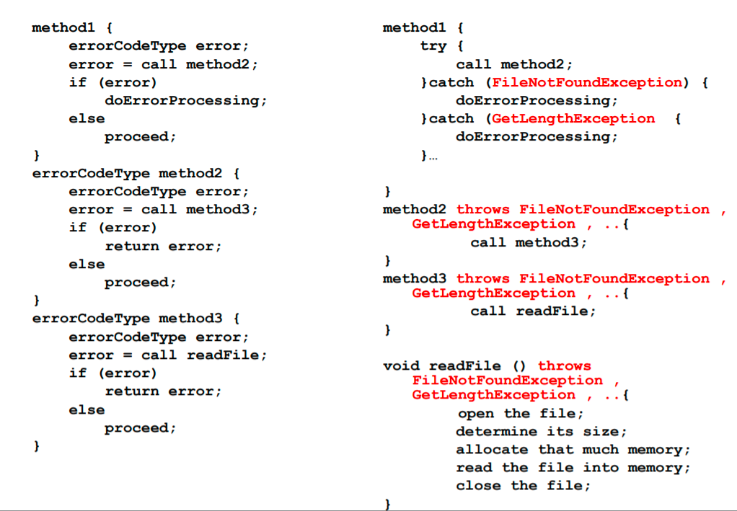
Propagating Errors Up the Call Stack

Slide 18
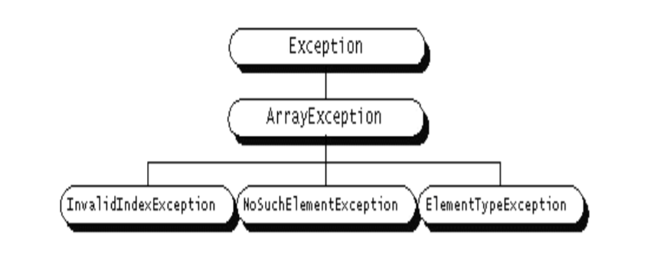
Grouping Error Types
Often exceptions fall into categories or groups
For example, you could imagine a group of exceptions that can occur when manipulating an array: the index is out of range for the size of the array, the element being inserted into the array is of the wrong type, or the element being searched for is not in the array.
Grouping or categorization of exceptions in a natural outcome of the class hierarchy

Slide 19
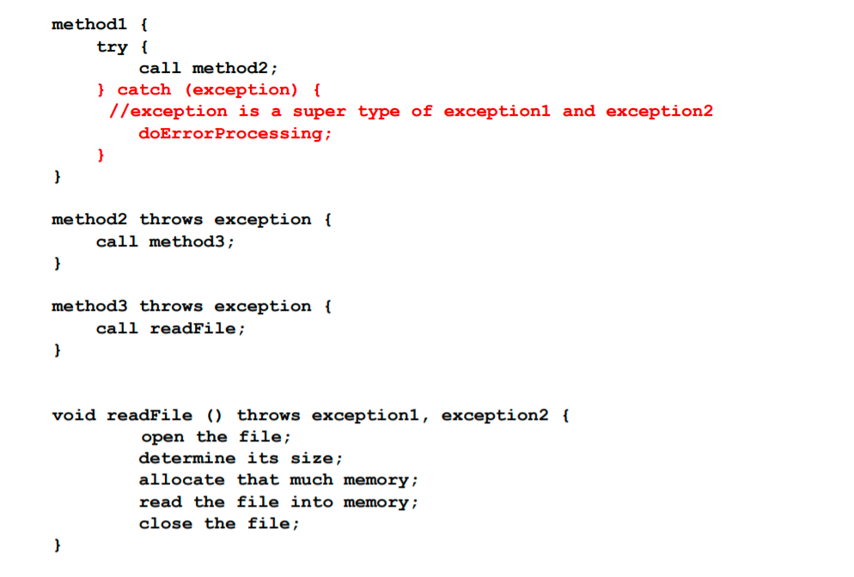
Grouping Error Types

